Slide 1
Traditional Symmetric-Key Ciphers
3.*
Notes:
*

Slide 2
Objectives
❏ To define the terms and the concepts of symmetric key ciphers
❏ To emphasize the two categories of traditional ciphers: substitution and transposition ciphers
❏ To describe the categories of cryptanalysis used to break the symmetric ciphers
❏ To introduce the concepts of the stream ciphers and block ciphers
3.*
Notes:
*

Slide 3
Figure shows the general idea behind a symmetric-key cipher. The original message from Alice to Bob is called plaintext; the message that is sent through the channel is called the ciphertext. To create the ciphertext from the plaintext, Alice uses an encryption algorithm and a shared secret key. To create the plaintext from ciphertext, Bob uses a decryption algorithm and the same secret key.
Topics discussed in this section:
Kerckhoff’s Principle Categories of Traditional Ciphers Cryptanalysis
3.*
Notes:
*

Slide 4
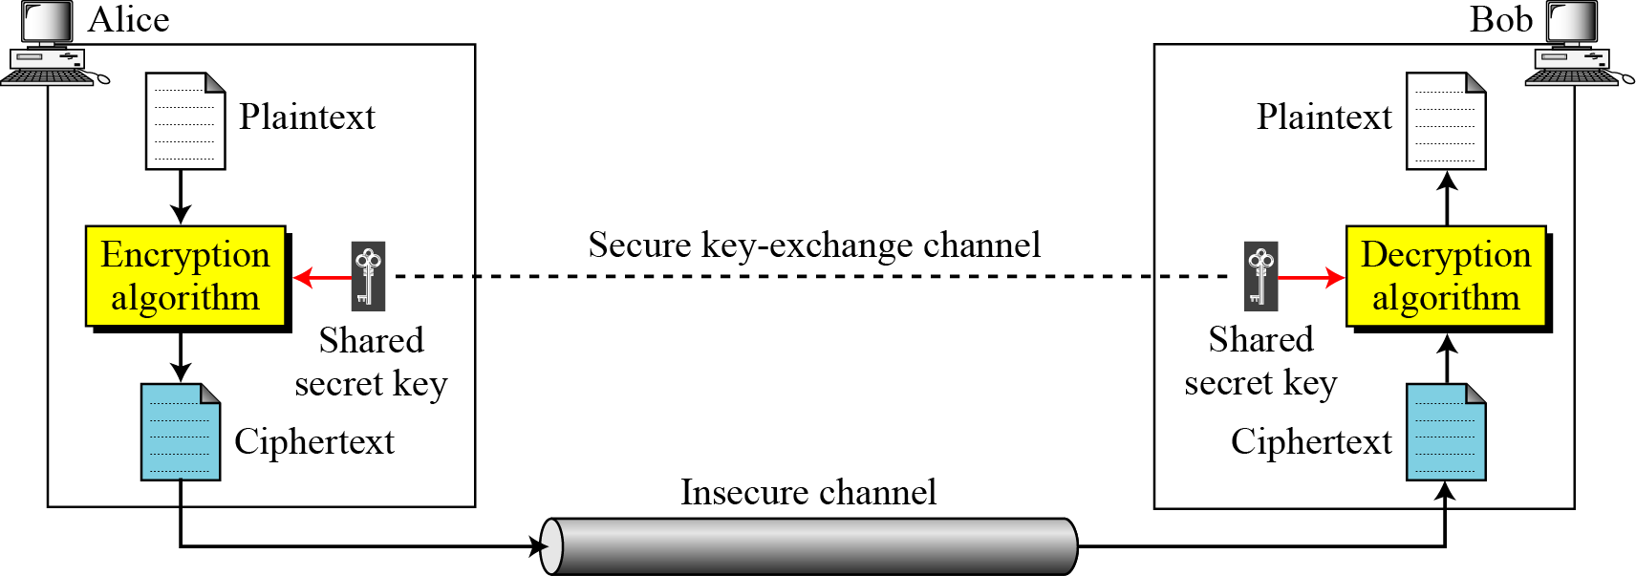
Figure General idea of symmetric-key cipher
3.*
Notes:
*

Slide 5
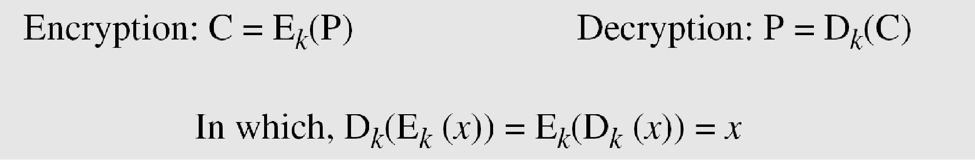
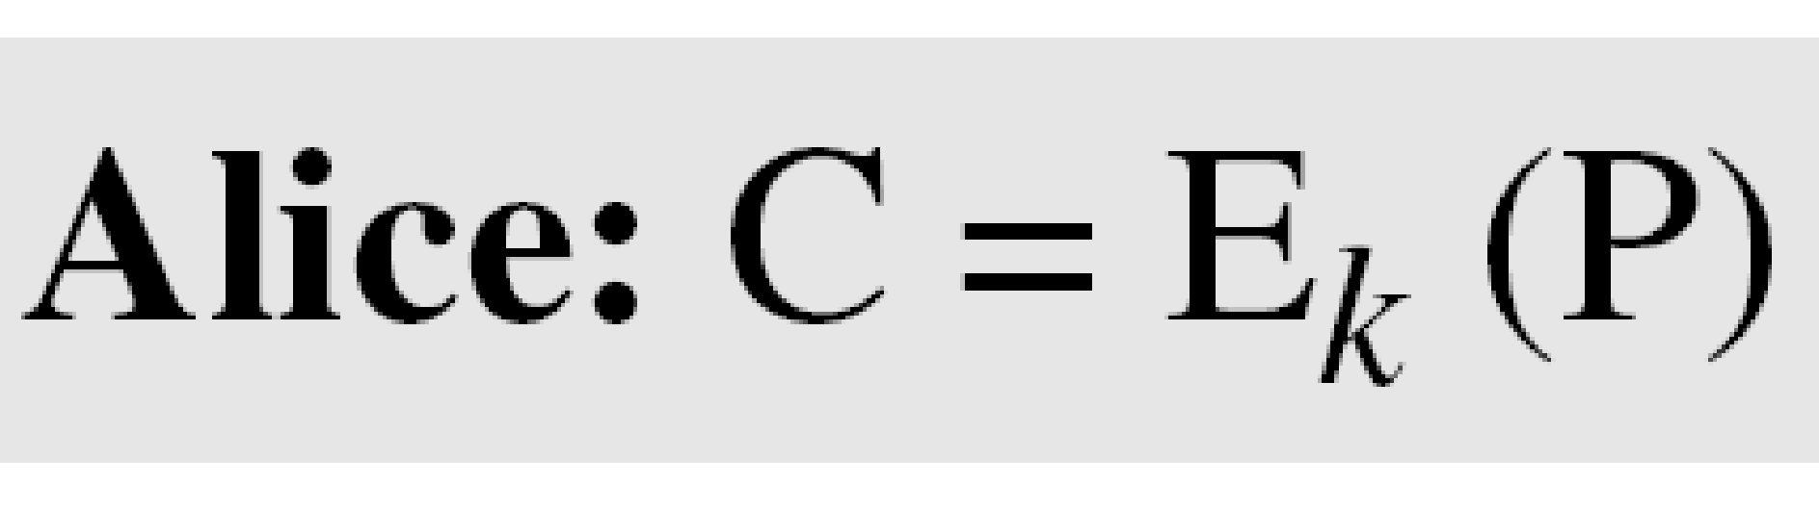
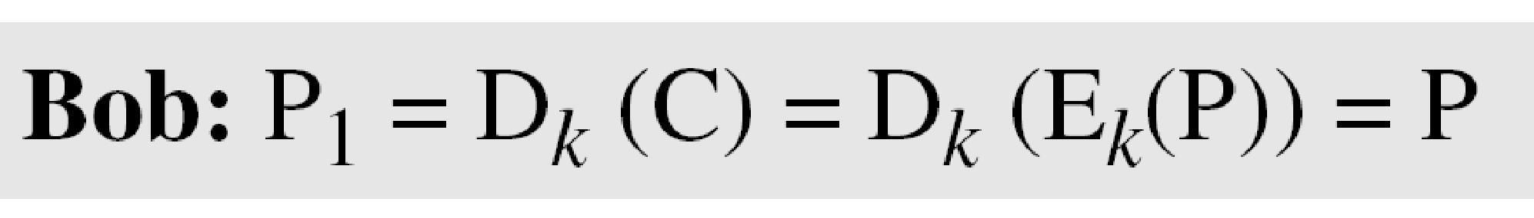
If P is the plaintext, C is the ciphertext, and K is the key,
We assume that Bob creates P₁; we prove that P₁ = P:
3.*
Notes:
*

Slide 6
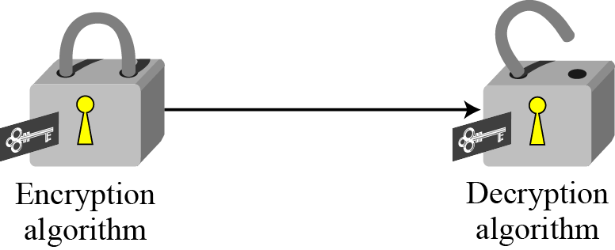
Figure 3.2 Locking and unlocking with the same key
3.*
Notes:
*

Slide 7
Kerckhoff’s Principle
Based on Kerckhoff’s principle, one should always assume that the adversary, Eve, knows the encryption/decryption algorithm. The resistance of the cipher to attack must be based only on the secrecy of the key.
3.*
Notes:
*

Slide 8
SUBSTITUTION CIPHERS
A substitution cipher replaces one symbol with another. Substitution ciphers can be categorized as either mono alphabetic ciphers or polyalphabetic ciphers.
Note
A substitution cipher replaces one symbol with another.
Topics discussed in this section:
Monoalphabetic Ciphres Polyalphabetic Ciphers
3.*
Notes:
*

Slide 9
Monoalphabetic Ciphers
Note
In monoalphabetic substitution, the relationship between a symbol in the plaintext to a symbol in the ciphertext is always one-to-one.
3.*
Notes:
*

Slide 10
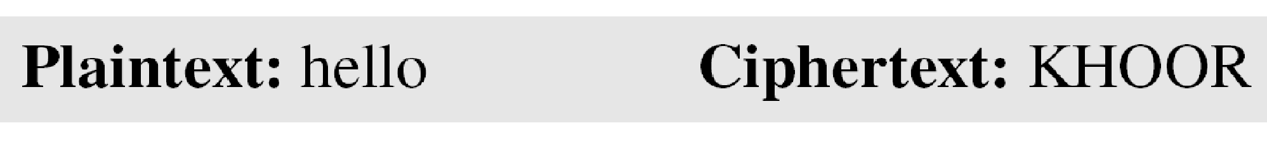
Example 3.1
The following shows a plaintext and its corresponding ciphertext. The cipher is probably monoalphabetic because both l’s (els) are encrypted as O’s.
Example 3.2
The following shows a plaintext and its corresponding ciphertext. The cipher is not monoalphabetic because each l (el) is encrypted by a different character.
Plain Text; hello Cipher text: ABNZF
3.*
Notes:
*

Slide 11
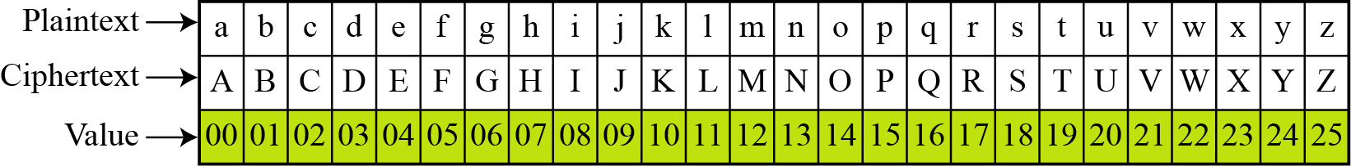
Additive Cipher
The simplest mono alphabetic cipher is the additive cipher. This cipher is sometimes called a shift cipher and sometimes a Caesar cipher, but the term additive cipher better reveals its mathematical nature.
Figure Plaintext and ciphertext in Z₂₆
3.*
Notes:
*

Slide 12
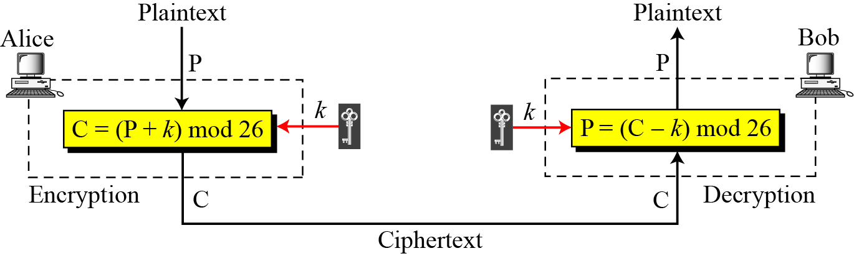
Figure Additive cipher
Note
When the cipher is additive, the plaintext, ciphertext, and key are integers in Z₂₆.
3.*
Notes:
*

Slide 13
Example 3.3
Use the additive cipher with key = 15 to encrypt the message “hello”.
Solution
We apply the encryption algorithm to the plaintext, character by character:
3.*
Notes:
*

Slide 14
Example 3.4
Use the additive cipher with key = 15 to decrypt the message “WTAAD”.
Solution
We apply the decryption algorithm to the plaintext character by character:
3.*
Notes:
*

Slide 15
Shift Cipher and Caesar Cipher
Historically, additive ciphers are called shift ciphers. Julius Caesar used an additive cipher to communicate with his officers. For this reason, additive ciphers are sometimes referred to as the Caesar cipher. Caesar used a key of 3 for his communications.
Note
Additive ciphers are sometimes referred to as shift ciphers or Caesar cipher.
3.*
Notes:
*

Slide 16
Example 3.5
Eve has intercepted the ciphertext “UVACLYFZLJBYL”. Show how she can use a brute-force attack to break the cipher.
Solution
Eve tries keys from 1 to 7. With a key of 7, the plaintext is “not very secure”, which makes sense.
3.*
Notes:
*

Slide 17
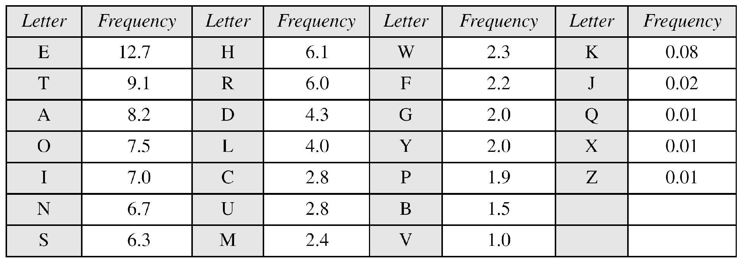
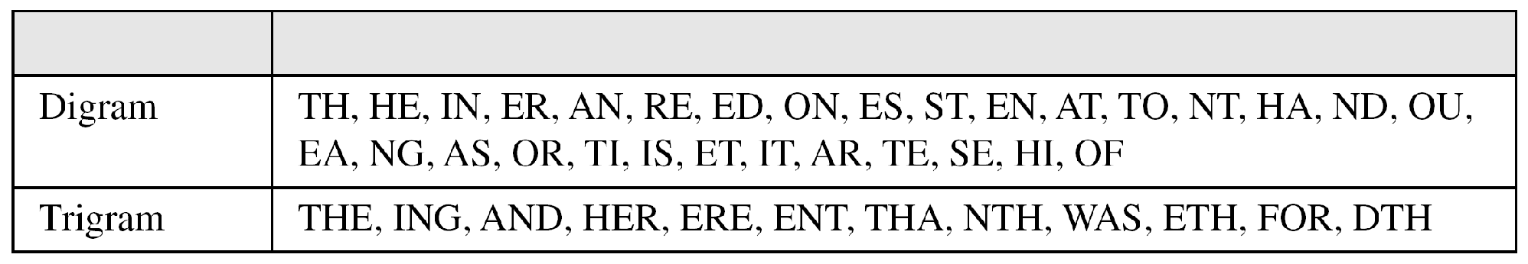
Table Frequency of characters in English
Table Frequency of diagrams and trigrams
3.*
Notes:
*

Slide 18
Example 3.6
Eve has intercepted the following ciphertext. Using a statistical attack, find the plaintext.
Solution
When Eve tabulates the frequency of letters in this ciphertext, she gets: I =14, V =13, S =12, and so on. The most common character is I with 14 occurrences. This means key = 4.
3.*
Notes:
*

Slide 19
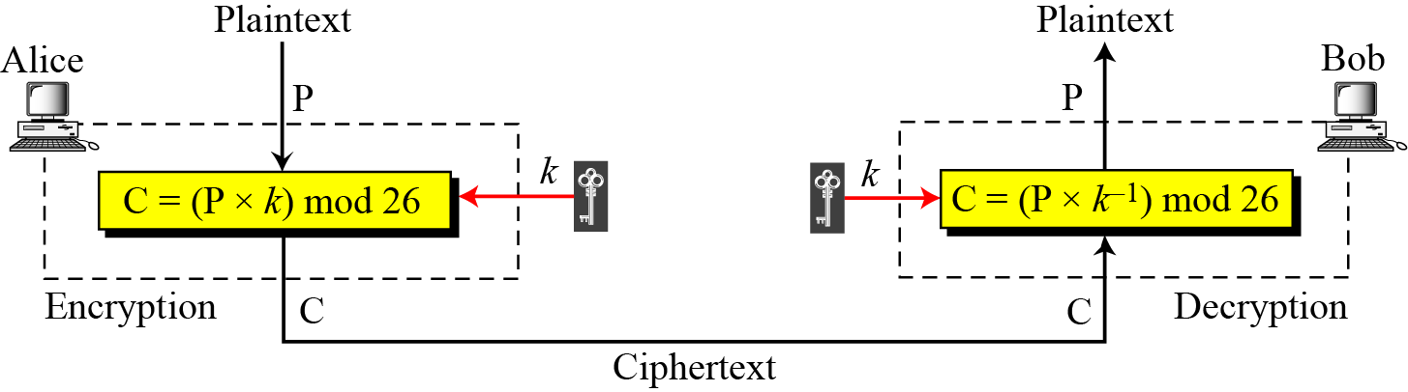
Multiplicative Ciphers
Figure 3.10 Multiplicative cipher
Note
In a multiplicative cipher, the plaintext and ciphertext are integers in Z₂₆; the key is an integer in Z26*
3.*
Notes:
*

Slide 20
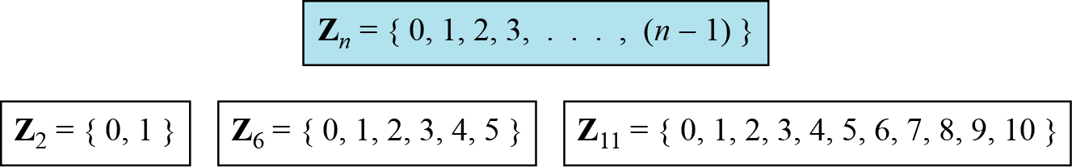
Set of Residues
The modulo operation creates a set, which in modular arithmetic is referred to as the set of least residues modulo n, or Z_{n}.
Figure Some Z_{n} sets

Slide 21
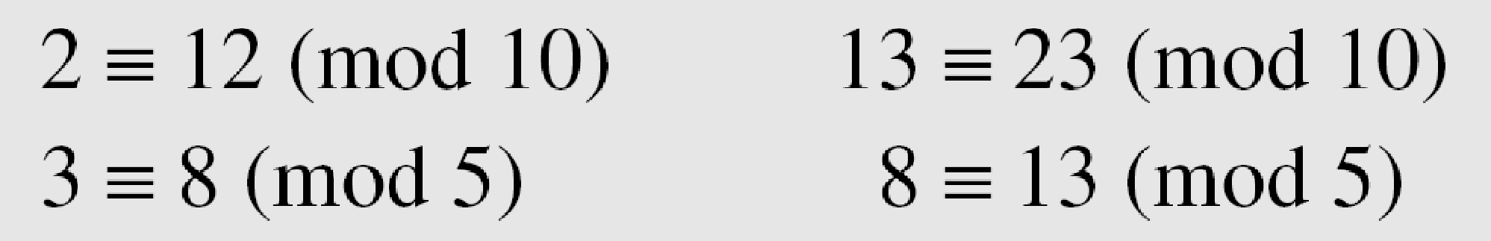
Congruence
To show that two integers are congruent, we use the congruence operator ( ≡ ). For example, we write:
In cryptography, we use the concept of congruence instead of equality. Mapping Z to Z_{n} is not one to one. Infinite numbers of Z can map to one member of Z_{n} .
For Ex. - the result of 2 mod 10 = 2, 12 mod 10 = 2, 22 mod 10 =2 , and so on.
In Modular arithmetic 2, 12, 22 are called congruent mod 10

Slide 22
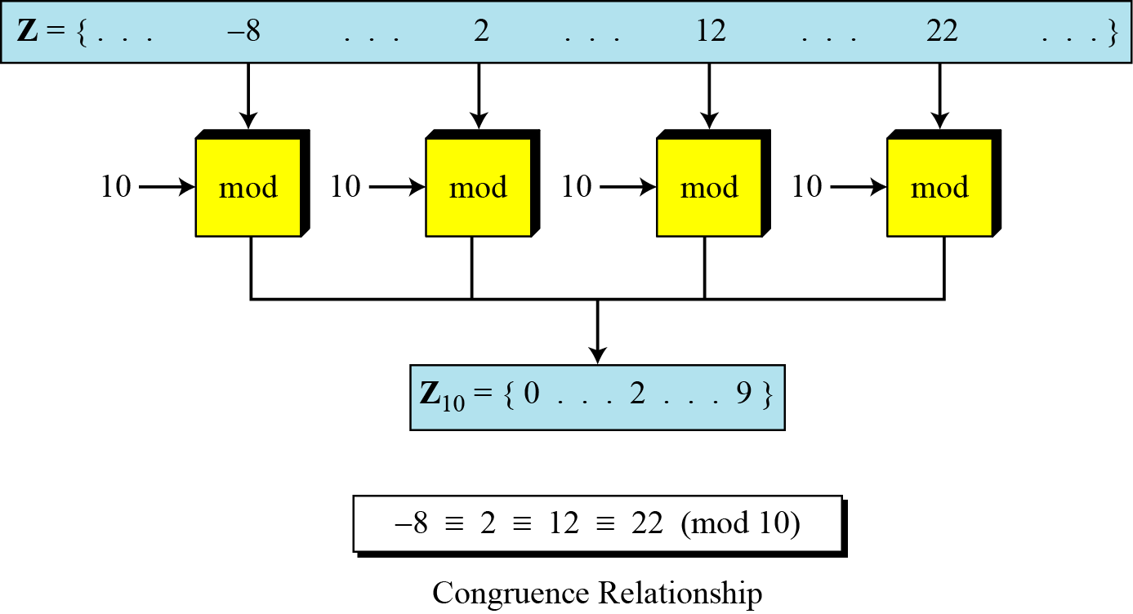
Figure Concept of congruence

Slide 23
Inverses
When we are working in modular arithmetic, we often need to find the inverse of a number relative to an operation. We are normally looking for an additive inverse (relative to an addition operation) or a multiplicative inverse (relative to a multiplication operation).

Slide 24

Additive Inverse
In Z_{n}, two numbers a and b are additive inverses of each other if
Note
In modular arithmetic, each integer has an additive inverse. The sum of an integer and its additive inverse is congruent to 0 modulo n.

Slide 25
Example
Find all additive inverse pairs in Z_{10.}
Solution
The six pairs of additive inverses are (0, 0), (1, 9), (2, 8), (3, 7), (4, 6), and (5, 5).

Slide 26

Multiplicative Inverse
In Z_{n}, two numbers a and b are the multiplicative inverse of each other if
Note
In modular arithmetic, an integer may or may not have a multiplicative inverse.
When it does, the product of the integer and its multiplicative inverse is congruent to 1 modulo n.

Slide 27
Example 2.22
Find the multiplicative inverse of 8 in Z₁₀.
Solution
There is no multiplicative inverse because gcd (10, 8) = 2 ≠ 1. In other words, we cannot find any number between 0 and 9 such that when multiplied by 8, the result is congruent to 1.
Example 2.23
Find all multiplicative inverses in Z₁₀.
Solution
There are only three pairs: (1, 1), (3, 7) and (9, 9). The numbers 0, 2, 4, 5, 6, and 8 do not have a multiplicative inverse.

Slide 28
Example 2.24
Find all multiplicative inverse pairs in Z₁₁.
Solution
We have seven pairs: (1, 1), (2, 6), (3, 4), (5, 9), (7, 8), (9, 9), and (10, 10).

Slide 29
Note
The extended Euclidean algorithm finds the multiplicative inverses of b in Z_{n} when n and b are given and gcd (n, b) = 1.
The multiplicative inverse of b is the value of t after being mapped to Z_{n}.

Slide 30
Note
The extended Euclidean algorithm finds the multiplicative inverses of b in Z_{n} when n and b are given and gcd (n, b) = 1.
The multiplicative inverse of b is the value of t after being mapped to Z_{n}.

Slide 31
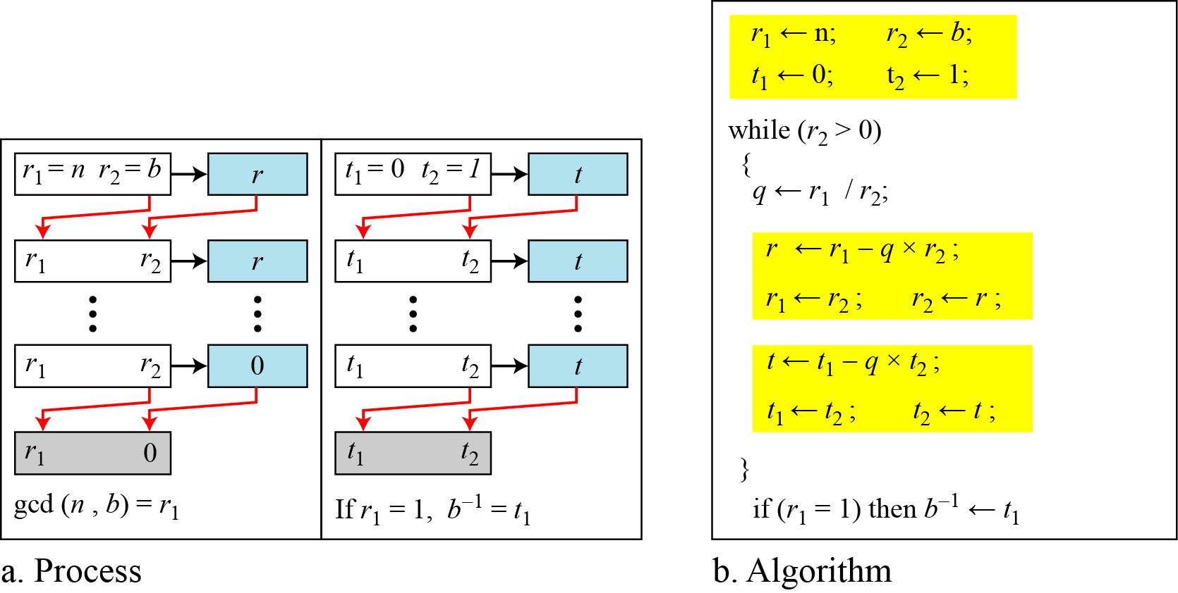
Figure Using extended Euclidean algorithm to find multiplicative inverse

Slide 32
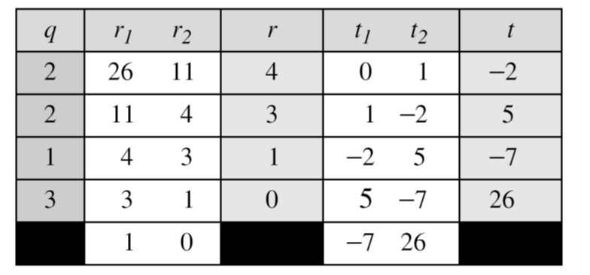
Example
Find the multiplicative inverse of 11 in Z₂₆.
Solution
The gcd (26, 11) is 1; the inverse of 11 is −7 or 19.

Slide 33
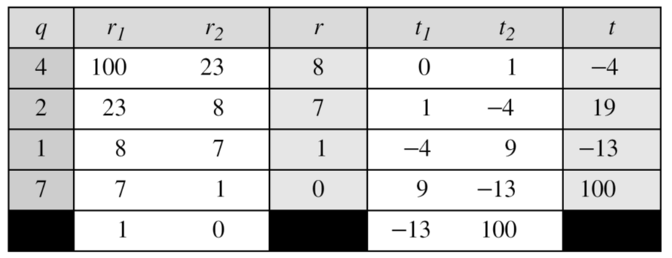
Example
Find the multiplicative inverse of 23 in Z₁₀₀.
Solution
The gcd (100, 23) is 1; the inverse of 23 is −13 or 87.

Slide 34
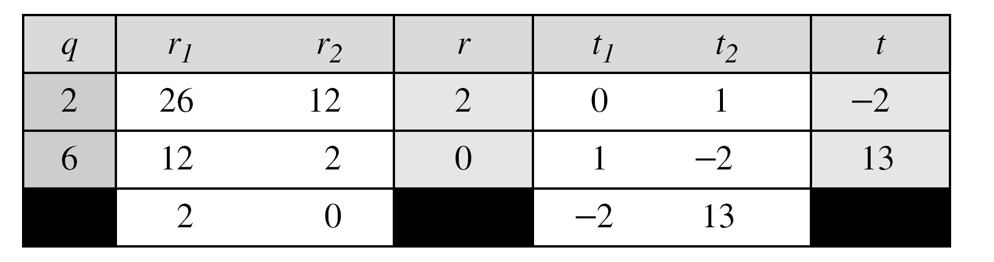
Example
Find the inverse of 12 in Z₂₆.
Solution
The gcd (26, 12) is 2; the inverse does not exist.

Slide 35
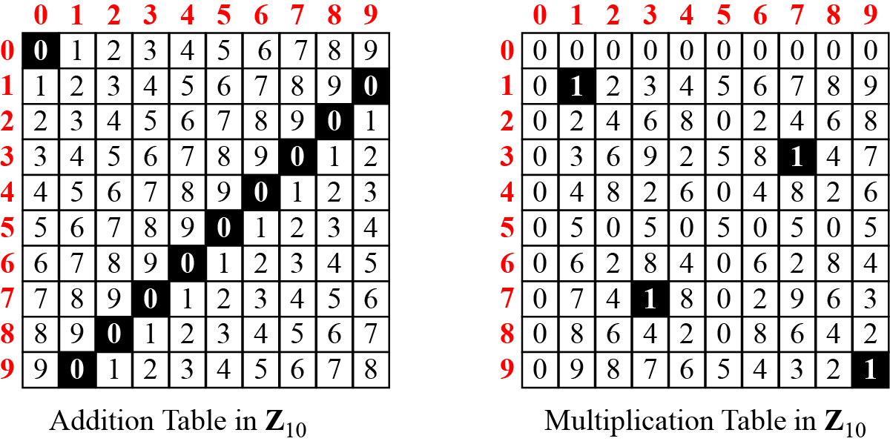
Addition and Multiplication Tables
Figure Addition and multiplication table for Z₁₀

Slide 36
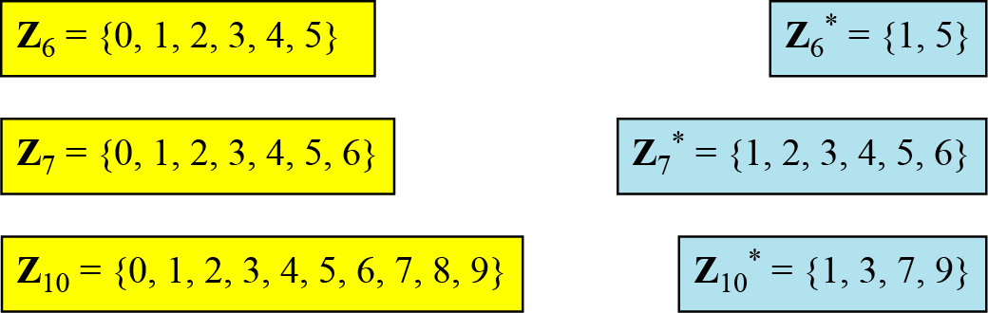
Different Sets
Figure Some Z_{n} and Z_{n*} sets
Note
We need to use Zn when additive inverses are needed; we need to use Zn* when multiplicative inverses are needed.

Slide 37
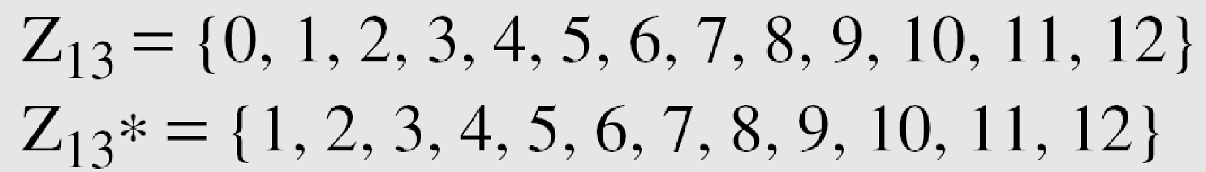
Two More Sets
Cryptography often uses two more sets: Z_{p} and Z_{p}*. The modulus in these two sets is a prime number.

Slide 38
Example 3.7
What is the key domain for any multiplicative cipher?
Solution
The key needs to be in Z₂₆*. This set has only 12 members: 1, 3, 5, 7, 9, 11, 15, 17, 19, 21, 23, 25.
Example 3.8
We use a multiplicative cipher to encrypt the message “hello” with a key of 7. The ciphertext is “XCZZU”.
3.*
Notes:
*

Slide 39
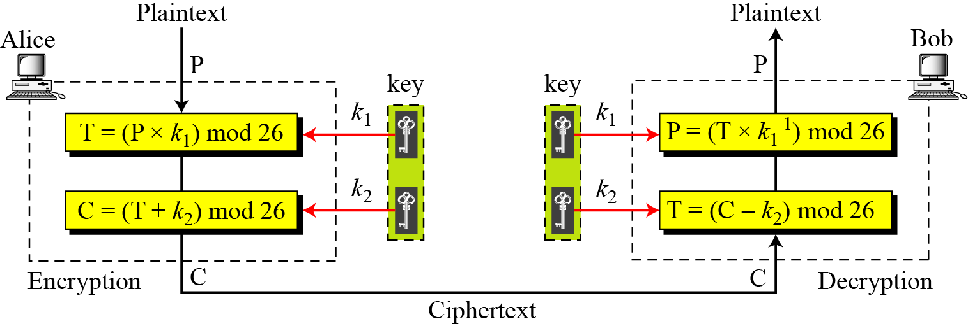
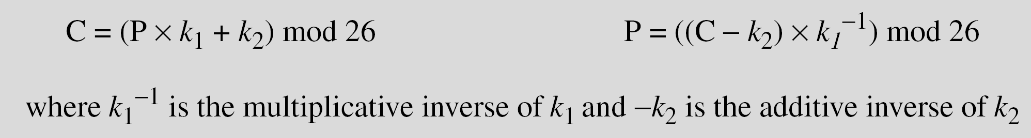
Affine Ciphers
Figure Affine cipher
3.*
Notes:
*

Slide 40
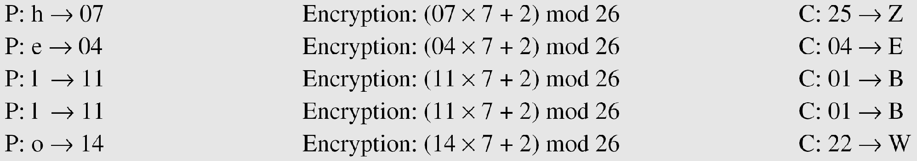
Example
The affine cipher uses a pair of keys in which the first key is from Z₂₆* and the second is from Z₂₆. The size of the key domain is 26 × 12 = 312.
Example
Use an affine cipher to encrypt the message “hello” with the key pair (7, 2).
3.*
Notes:
*

Slide 41
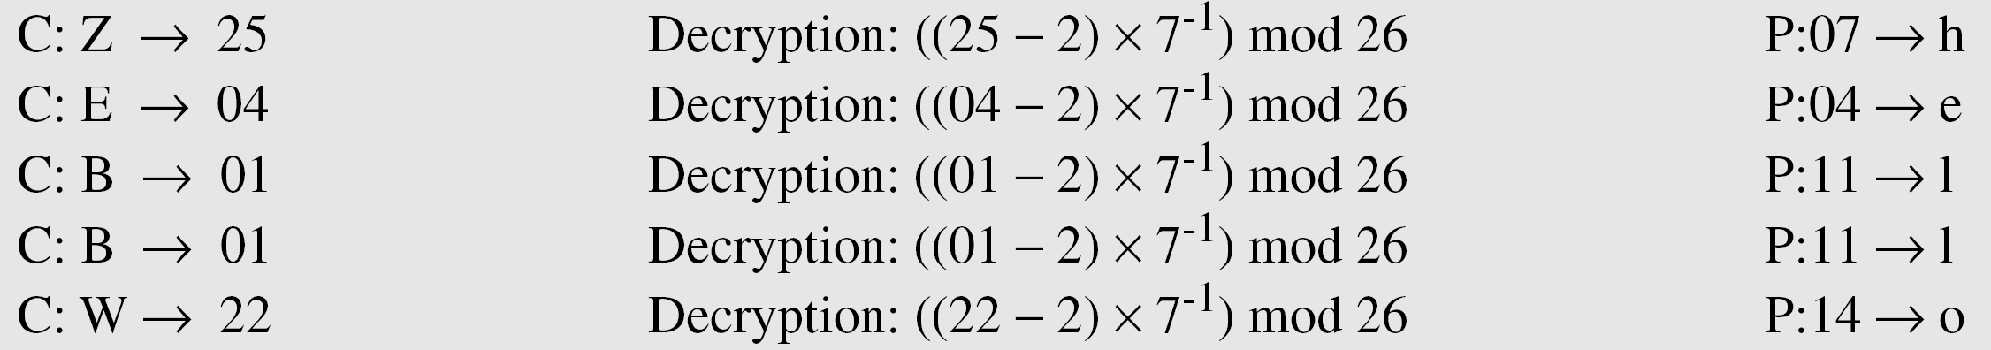
Example 3.11
Use the affine cipher to decrypt the message “ZEBBW” with the key pair (7, 2) in modulus 26.
Solution
Example 3.12
The additive cipher is a special case of an affine cipher in which k₁ = 1. The multiplicative cipher is a special case of affine cipher in which k₂ = 0.
3.*
Notes:
*

Slide 42
Monoalphabetic Substitution Cipher
Because additive, multiplicative, and affine ciphers have small key domains, they are very vulnerable to brute-force attack.
A better solution is to create a mapping between each plaintext character and the corresponding ciphertext character. Alice and Bob can agree on a table showing the mapping for each character.
Figure 3.12 An example key for monoalphabetic substitution cipher
3.*
Notes:
*

Slide 43
Example 3.13
We can use the key in Figure to encrypt the message
The ciphertext is
3.*
Notes:
*

Slide 44
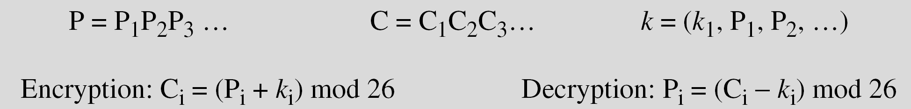
Polyalphabetic Ciphers
In polyalphabetic substitution, each occurrence of a character may have a different substitute. The relationship between a character in the plaintext to a character in the ciphertext is one-to-many.
Autokey Cipher
3.*
Notes:
*

Slide 45
Example 3.14
Assume that Alice and Bob agreed to use an autokey cipher with initial key value k1 = 12. Now Alice wants to send Bob the message “Attack is today”. Enciphering is done character by character.
3.*
Notes:
*

Slide 46
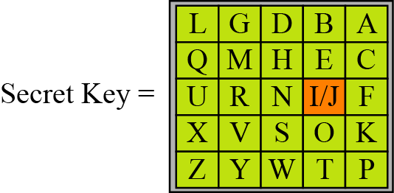
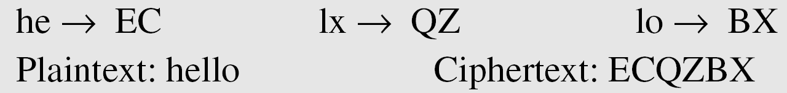
Playfair Cipher
Figure An example of a secret key in the Playfair cipher
Example 3.15
Let us encrypt the plaintext “hello” using the key in given Figure
3.*
Notes:
*

Slide 47
Playfair Cipher Rules
Any sequence of 25 letters can be used as a key, so long as all letters are in it and there are no repeats. There is no 'j', it is combined with 'i'.
Identify any double letters in the plaintext and replace the second occurrence with an 'x' e.g. 'hammer' -> 'ha mx me r'.
If the plaintext has an odd number of characters, append an 'x' to the end to make it even.
Break the plaintext into pairs of letters, e.g. 'hamxer' -> 'ha mx er'
Locate the letters in the key square, (the examples given are using the key square above)
If the letters appear on the same row of your table, replace them with the letters to their immediate right respectively (wrapping around to the left side of the row if a letter in the original pair was on the right side of the row).
If the letters appear on the same column of your table, replace them with the letters immediately below respectively (wrapping around to the top side of the column if a letter in the original pair was on the bottom side of the column).
If the letters are not on the same row or column, replace them with the letters in their own row but in the same column as the other letter.
Notes:
*

Slide 48
Cryptanalysis of Playfair Cipher
Brute force is difficult
Size of key domain 25!
Hides single letter frequency of characters
Cryptanalyst can have ciphertext only attack based on diagram frequency test to find the key

Slide 49
Vigenere Cipher
Example 3.16
We can encrypt the message “She is listening” using the 6-character keyword “PASCAL”.
3.*
Notes:
*

Slide 50
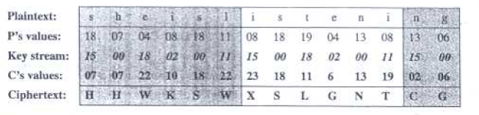
Example 3.16
Let us see how we can encrypt the message “She is listening” using the 6-character keyword “PASCAL”. The initial key stream is (15, 0, 18, 2, 0, 11). The key stream is the repetition of this initial key stream (as many times as needed).
3.*
Notes:
*

Slide 51
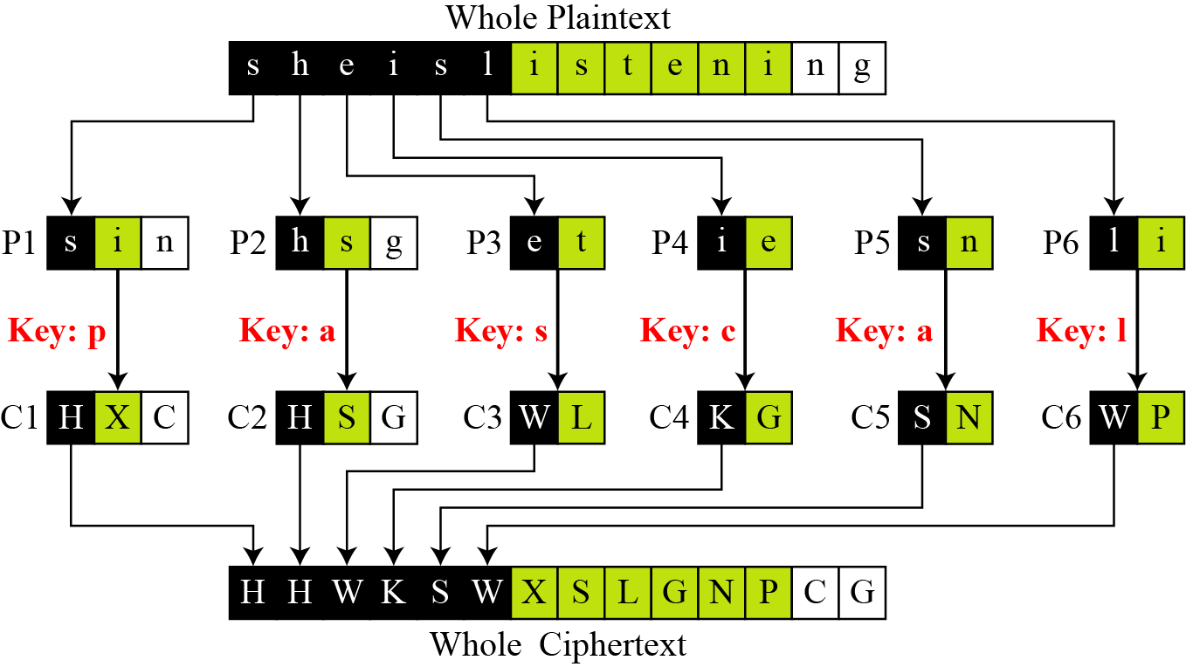
Example 3.17
Vigenere cipher can be seen as combinations of m additive ciphers.
Figure A Vigenere cipher as a combination of m additive ciphers
3.*
Notes:
*

Slide 52
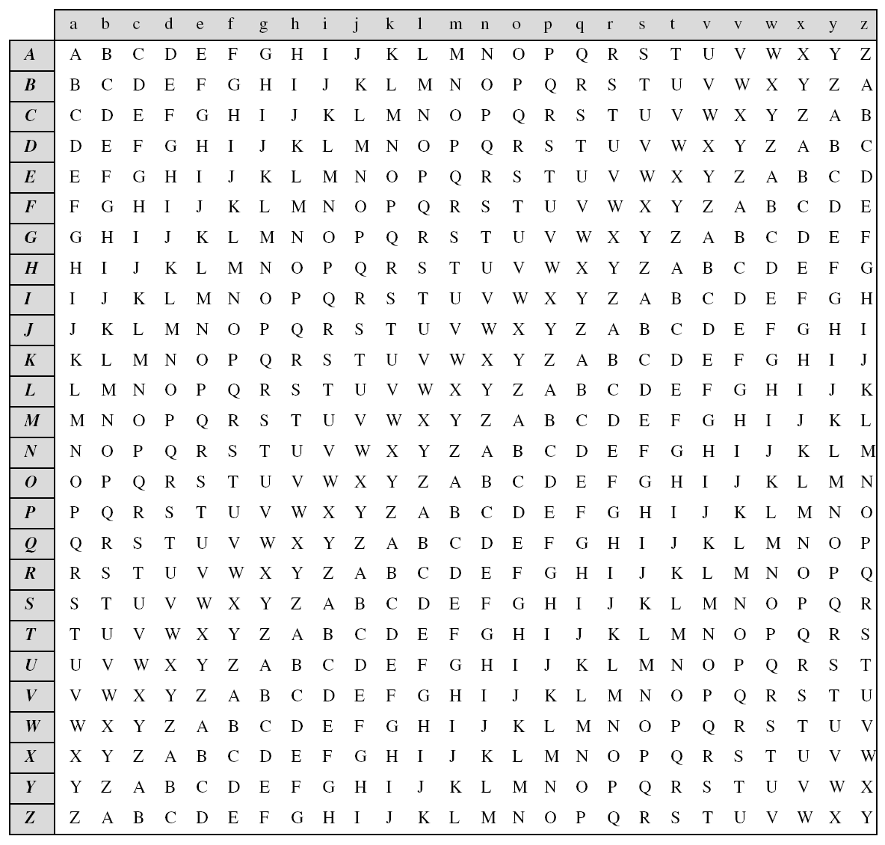
Example 3.18
Using Example, we can say that the additive cipher is a special case of Vigenere cipher in which m = 1.
Table 3.3
A Vigenere Tableau
3.*
Notes:
*

Slide 53
Vigenere Cipher (Cryptanalysis)
Does not preserve frequency of characters
cryptanalysis will be based on finding length of the key and finding key itself
The Kasiski test for repetition of three-character segments yields the results
If two of these segments are found at distance d, the analyst assumes d/m where m is the key length
If more of repeated segments are found with distances d1,d2,..dn then gcd(d1,d2,..dn)/m
Segment of three letters avoids cases where characters in key are not distinct

Slide 54
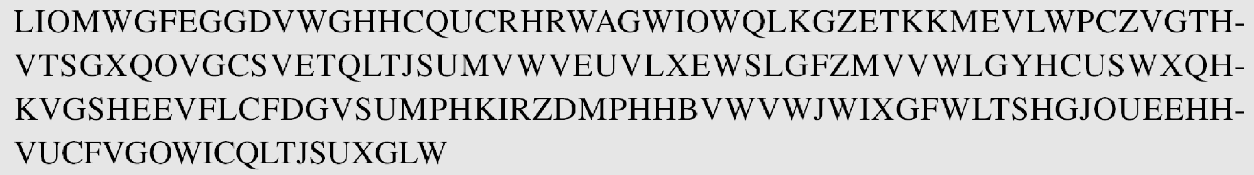
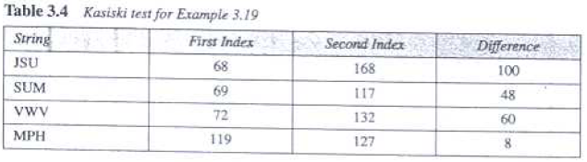
Vigenere Cipher (Cryptanalysis)
Example 3.19
Let us assume we have intercepted the following ciphertext:
The Kasiski test for repetition of three-character segments yields the results shown in Table
3.*
Notes:
*

Slide 55
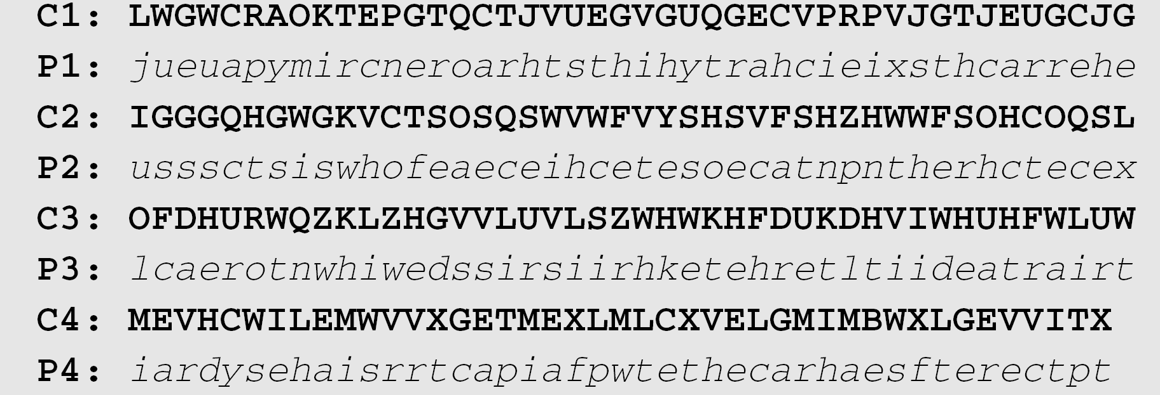

Example 3.19
The greatest common divisor of differences is 4, which means that the key length is multiple of 4. First try m = 4.
In this case, the plaintext makes sense.
3.*
Notes:
*

Slide 56
One-Time Pad
Maintains perfect secrecy.
Each plaintext symbol is encrypted with a key randomly chosen from a key domain
This idea is used in a cipher called one-time pad, invented by Vernam.
Impossible to implement commercially as needs random keys be exchanged everytime
3.*
Notes:
*

Slide 57
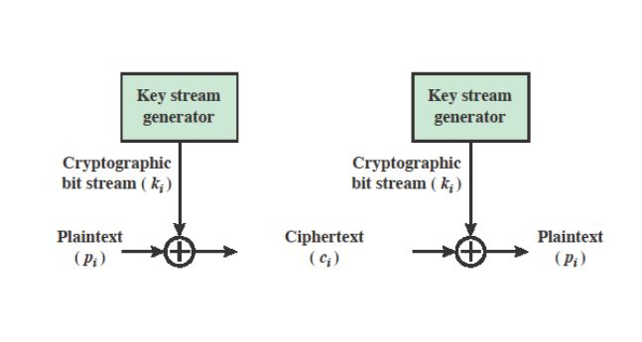
Vernam Cipher
Randomly generated

Slide 58
TRANSPOSITION CIPHERS
A transposition cipher does not substitute one symbol for another, instead it changes the location of the symbols.
Note
A transposition cipher reorders symbols.
Topics discussed in this section:
Keyless Transposition Ciphers Keyed Transposition Ciphers Combining Two Approaches
3.*
Notes:
*

Slide 59
Keyless Transposition Ciphers
Simple transposition ciphers, which were used in the past, are keyless.
Example 3.22
A good example of a keyless cipher using the first method is the rail fence cipher. The ciphertext is created reading the pattern row by row. For example, to send the message “Meet me at the park” to Bob, Alice writes
She then creates the ciphertext “MEMATEAKETETHPR”.
3.*
Notes:
*

Slide 60
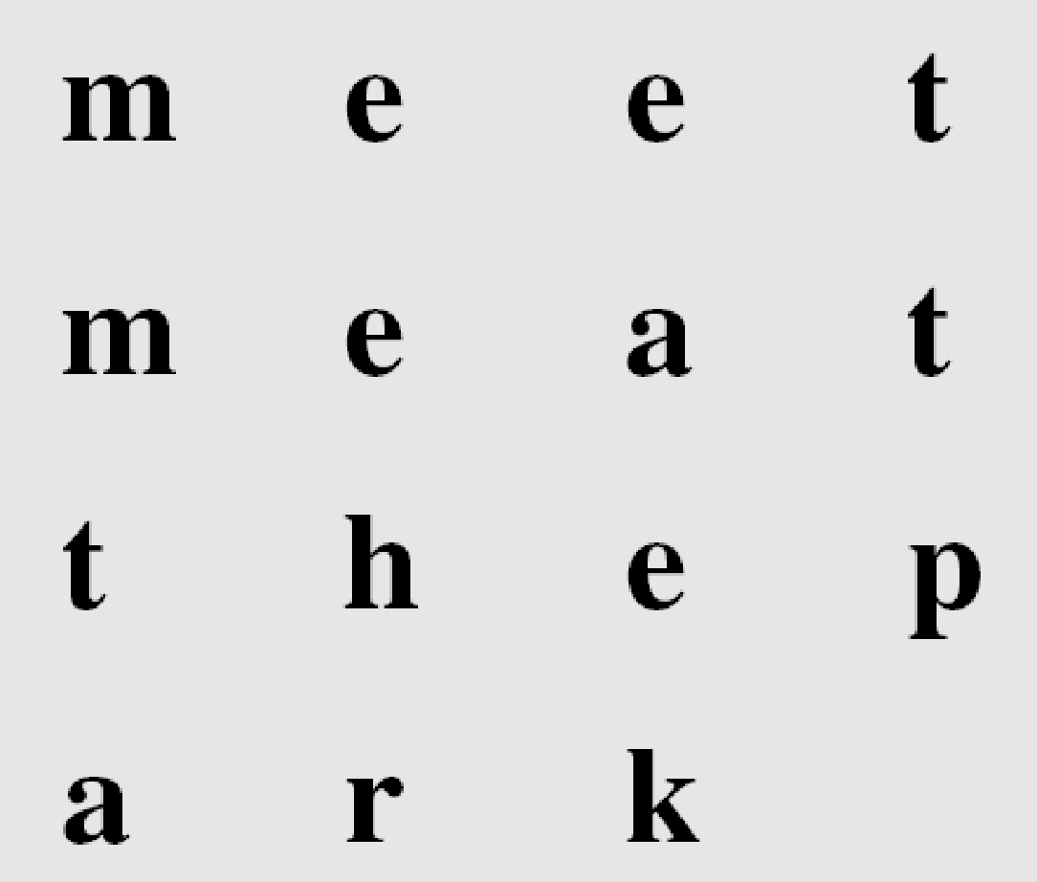
Example 3.23
Alice and Bob can agree on the number of columns and use the second method. Alice writes the same plaintext, row by row, in a table of four columns.
She then creates the ciphertext “MMTAEEHREAEKTTP”.
3.*
Notes:
*

Slide 61
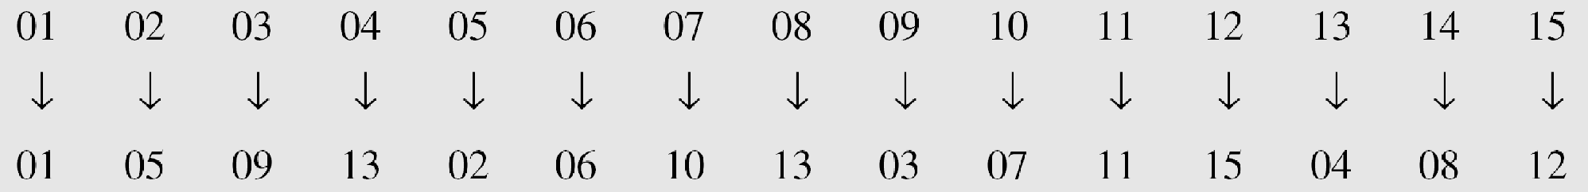
Example 3.24
The cipher in Example is actually a transposition cipher. The following shows the permutation of each character in the plaintext into the ciphertext based on the positions.
The second character in the plaintext has moved to the fifth position in the ciphertext; the third character has moved to the ninth position; and so on. Although the characters are permuted,
there is a pattern in the permutation: (01, 05, 09, 13), (02, 06, 10, 13), (03, 07, 11, 15), and (08, 12). In each section, the difference between the two adjacent numbers is 4.
3.*
Notes:
*

Slide 62
Keyed Transposition Ciphers
The keyless ciphers permute the characters by using writing plaintext in one way and reading it in another way
The permutation is done on the whole plaintext to create the whole ciphertext.
Another method is to divide the plaintext into groups of predetermined size, called blocks, and then use a key to permute the characters in each block separately.
3.*
Notes:
*

Slide 63
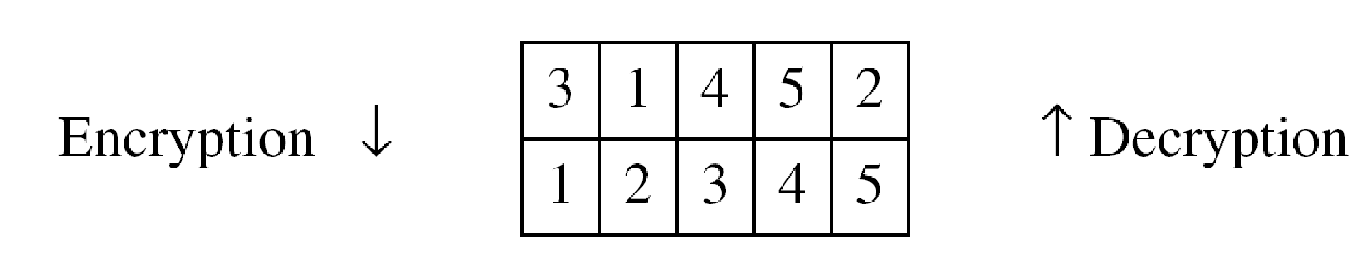
Example 3.25
Alice needs to send the message “Enemy attacks tonight” to Bob..
The key used for encryption and decryption is a permutation key, which shows how the character are permuted.
The permutation yields
3.*
Notes:
*

Slide 64
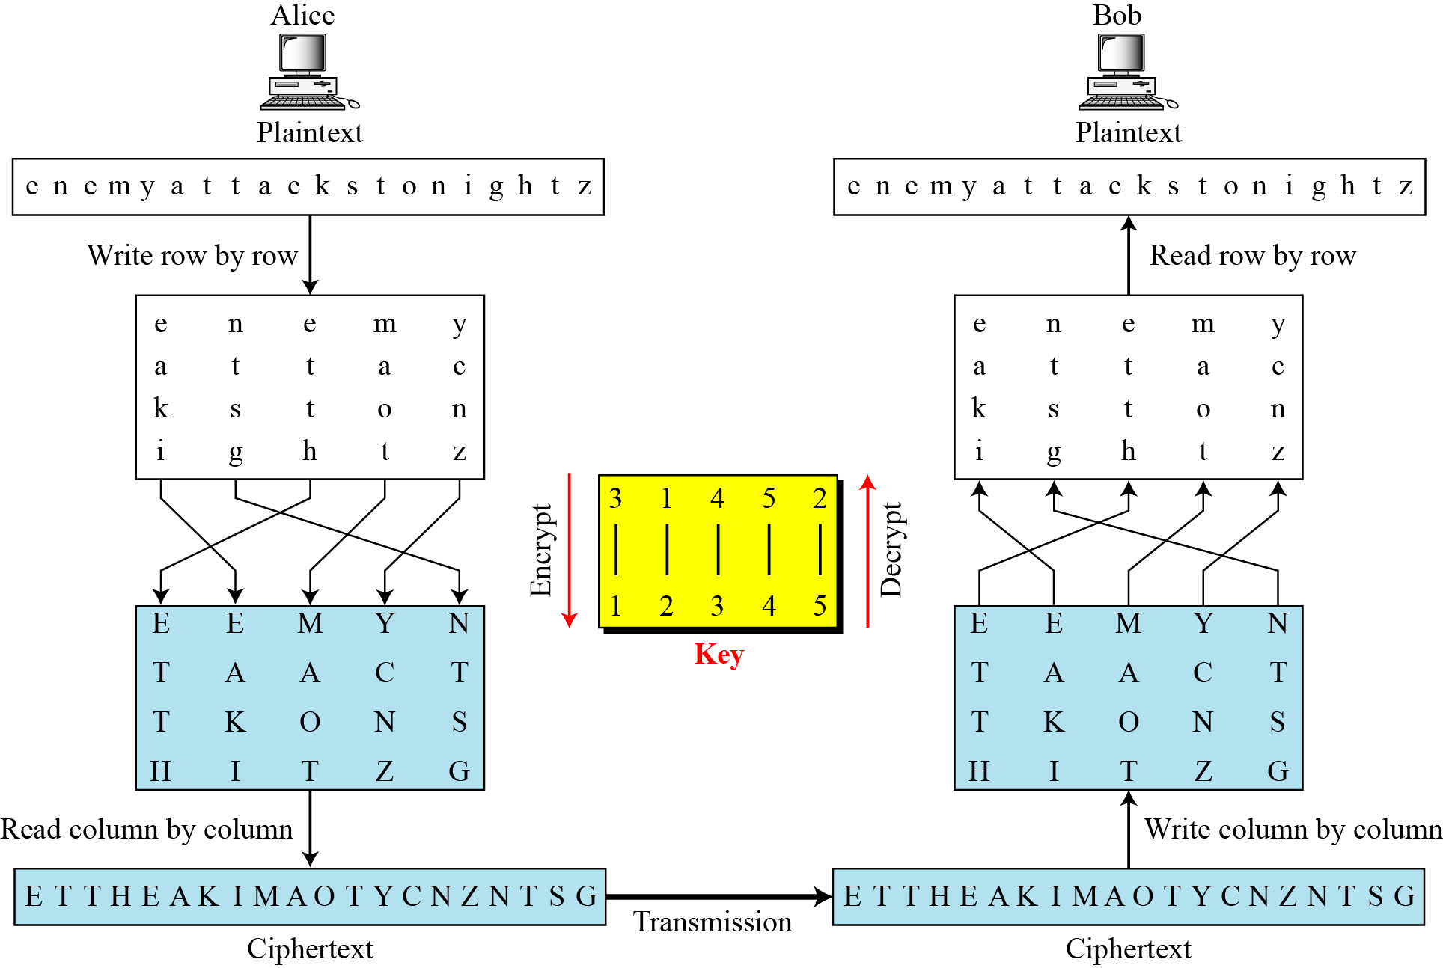
Combining Two Approaches
Example 3.26
Figure
3.*
Notes:
*

Slide 65
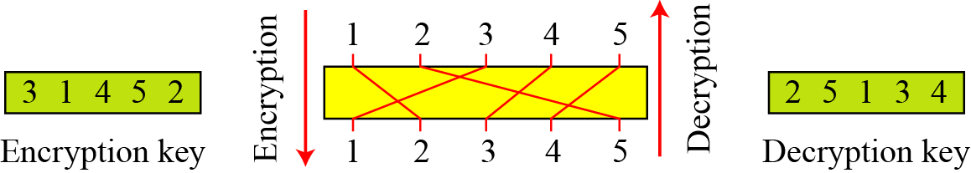
Keys
In Example, a single key was used in two directions for the column exchange: downward for encryption, upward for decryption. It is customary to create two keys.
Figure Encryption/decryption keys in transpositional ciphers
3.*
Notes:
*

Slide 66
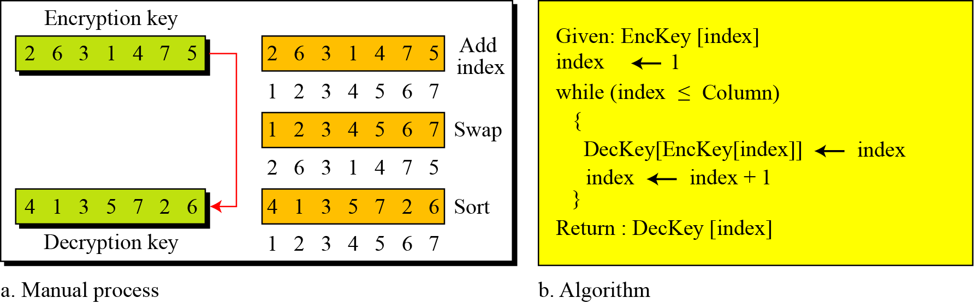
Figure Key inversion in a transposition cipher
3.*
Notes:
*

Slide 67
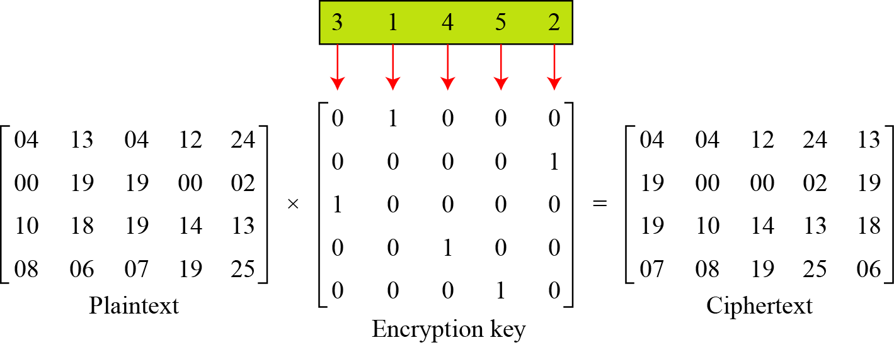
Using Matrices
We can use matrices to show the encryption/decryption process for a transposition cipher.
Example 3.27
Figure Representation of the key as a matrix in the transposition cipher
3.*
Notes:
*

Slide 68
Example 3.27
Figure shows the encryption process. Multiplying the 4 × 5 plaintext matrix by the 5 × 5 encryption key gives the 4 × 5 ciphertext matrix.
Figure Representation of the key as a matrix in the transposition cipher
3.*
Notes:
*

Slide 69
Cryptanalysis of transposition ciphers
Vulnerable to various kinds of ciphertext only attacks

Slide 70
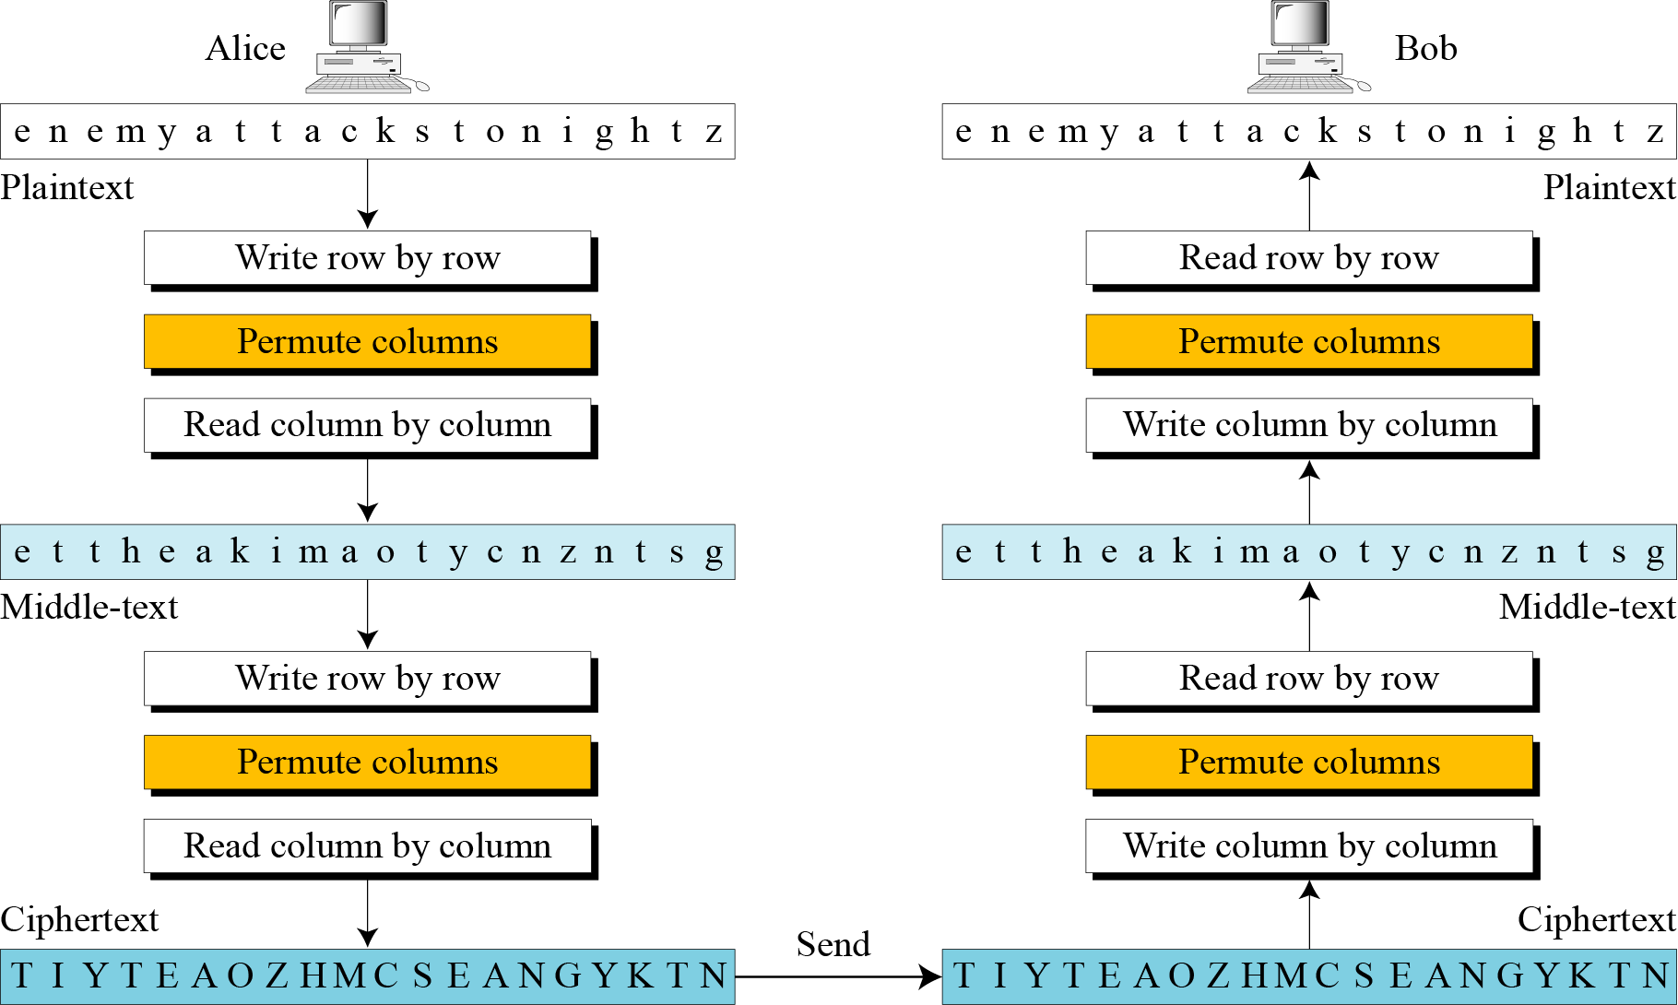
Double Transposition Ciphers
Figure Double transposition cipher
3.*
Notes:
*

Slide 71
STREAM AND BLOCK CIPHERS
The literature divides the symmetric ciphers into two broad categories: stream ciphers and block ciphers. Although the definitions are normally applied to modern ciphers, this categorization also applies to traditional ciphers.
Topics discussed in this section:
Stream Ciphers Block Ciphers
Combination
3.*
Notes:
*

Slide 72
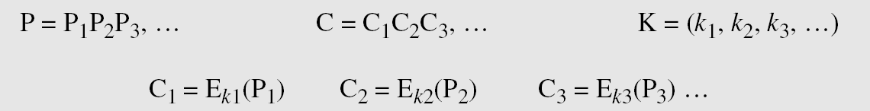
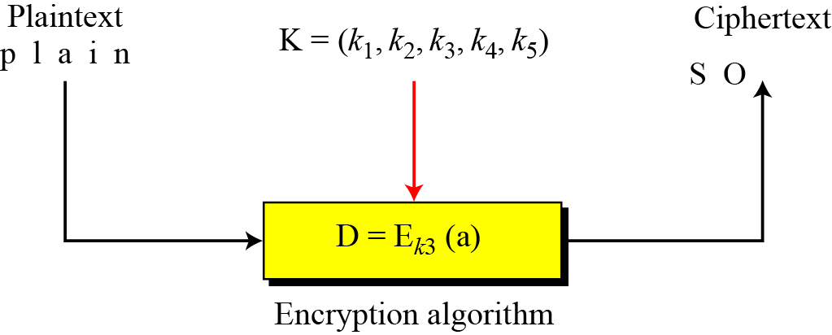
Stream Ciphers
Call the plaintext stream P, the ciphertext stream C, and the key stream K.
Figure Stream cipher
3.*
Notes:
*

Slide 73
Example 3.30
Additive ciphers can be categorized as stream ciphers in which the key stream is the repeated value of the key. In other words, the key stream is considered as a predetermined stream of keys or K = (k, k, …, k). In this cipher, however, each character in the ciphertext depends only on the corresponding character in the plaintext, because the key stream is generated independently.
Example 3.31
The monoalphabetic substitution ciphers discussed in this chapter are also stream ciphers. However, each value of the key stream in this case is the mapping of the current plaintext character to the corresponding ciphertext character in the mapping table.
3.*
Notes:
*

Slide 74
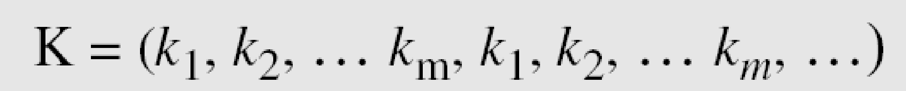
Example 3.32
Vigenere ciphers are also stream ciphers according to the definition. In this case, the key stream is a repetition of m values, where m is the size of the keyword. In other words,
Example 3.33
We can establish a criterion to divide stream ciphers based on their key streams. We can say that a stream cipher is a monoalphabetic cipher if the value of k_{i} does not depend on the position of the plaintext character in the plaintext stream; otherwise, the cipher is polyalphabetic.
3.*
Notes:
*

Slide 75
Example 3.33
Additive ciphers are definitely monoalphabetic because k_{i} in the key stream is fixed; it does not depend on the position of the character in the plaintext.
Monoalphabetic substitution ciphers are monoalphabetic because k_{i} does not depend on the position of the corresponding character in the plaintext stream; it depends only on the value of the plaintext character.
Vigenere ciphers are polyalphabetic ciphers because k_{i} definitely depends on the position of the plaintext character. However, the dependency is cyclic. The key is the same for two characters m positions apart.
3.*
Notes:
*

Slide 76
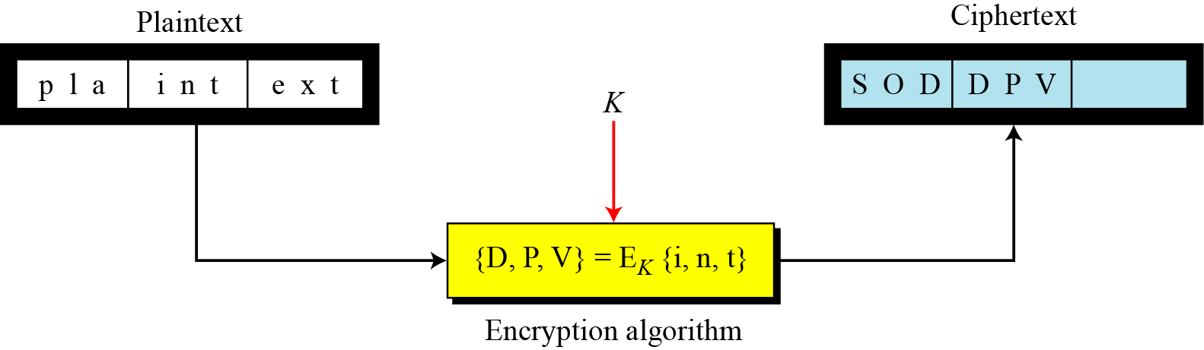
Block Ciphers
In a block cipher, a group of plaintext symbols of size m (m > 1) are encrypted together creating a group of ciphertext of the same size. A single key is used to encrypt the whole block even if the key is made of multiple values. Figure 3.27 shows the concept of a block cipher.
Figure Block cipher
3.*
Notes:
*

Slide 77
Example 3.34
Playfair ciphers are block ciphers. The size of the block is m = 2. Two characters are encrypted together.
Hill ciphers are block ciphers. A block of plaintext, of size 2 or more is encrypted together using a single key (a matrix). In these ciphers, the value of each character in the ciphertext depends on
all the values of the characters in the plaintext. Although the key is made of m × m values, it is considered as a single key.
From the definition of the block cipher, it is clear that every block cipher is a polyalphabetic cipher because each character in a ciphertext block depends on all characters in the plaintext block.
3.*
Notes:
*

Slide 78
In practice, blocks of plaintext are encrypted individually, but they use a stream of keys to encrypt the whole message block by block. In other words, the cipher is a block cipher when looking at the individual blocks, but it is a stream cipher when looking at the whole message considering each block as a single unit.
3.*
Notes:
*

Slide 79

Diffusion
The idea of diffusion is to hide the relationship between the ciphertext and the plaintext.
In diffusion, the statistical structure of the plaintext is dissipated into long range statistics of the ciphertext.
Each plaintext digit affects the value of many ciphertext digits
Note
Diffusion hides the relationship between the ciphertext and the plaintext.

Slide 80
Confusion
The idea of confusion is to hide the relationship between the ciphertext and the key.
Confusion seeks to make the relationship between the statistics of ciphertext and the value of the encryption key as complex as possible.
Confusion hides the relationship between the ciphertext and the key.
Note

Slide 81
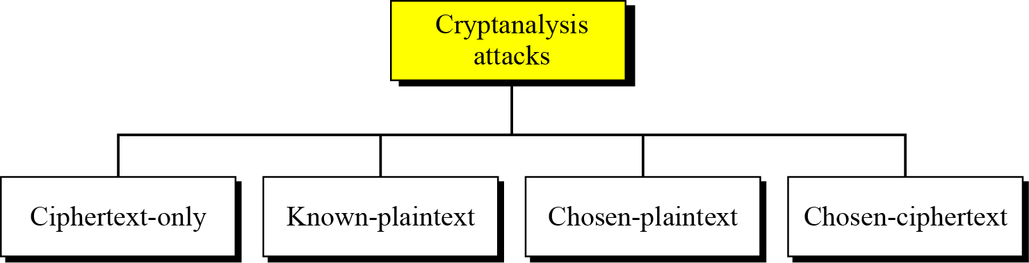
Cryptanalysis
As cryptography is the science and art of creating secret codes, cryptanalysis is the science and art of breaking those codes.
Figure Cryptanalysis attacks
3.*
Notes:
*

Slide 82
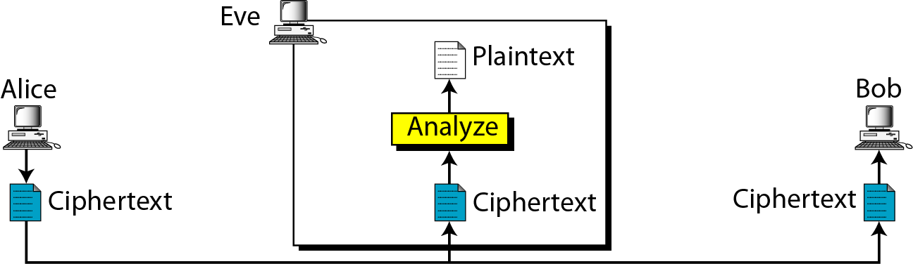
Ciphertext-Only Attack
Figure Ciphertext-only attack
Eve knows encryption algorithm and can intercept Ciphertext
3.*
Notes:
*

Slide 83
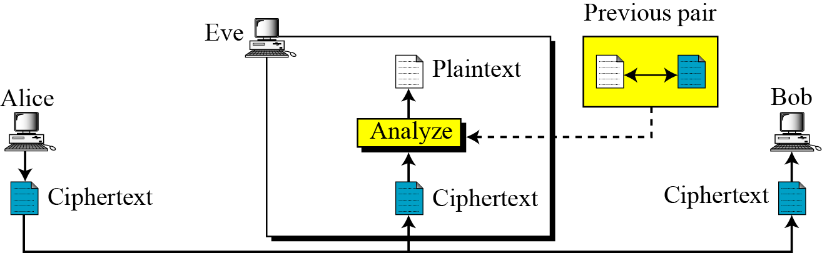
Known-Plaintext Attack
Figure Known-plaintext attack
Eve has access to some plaintext –ciphertext pairs in addition to some intercepted ciphertext that she wants to break
3.*
Notes:
*

Slide 84

Chosen-Plaintext Attack
Figure Chosen-plaintext attack
Eve chooses plaintext-ciphertext pairs; This happens when she has access to Alice’s Computer.
3.*
Notes:
*

Slide 85

Chosen-Ciphertext Attack
Figure Chosen-ciphertext attack
Eve chooses some ciphertext and decrypts it to form a plaintext-ciphertext pair. This happens when she has access to Bob’s Computer.
3.*
Notes:
*

Slide 86
The end

